Slide 1
RACISM
Blade. S, Will. A, Ruben. S, Jake. T

Slide 2


JASPER JONES
https://www.youtube.com/watch?v=FGg_Pa3ZEGk

Slide 3
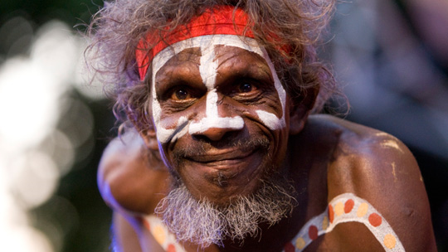
RACIAL DISCRIMINATION ACT: THE TWO MINUTE VERSION
https://www.amnesty.org.au/racial-discrimination-act-the-two-minute-version/?gclid=COqF8oezjNICFYGWvAodQKkFtg

Slide 4
http://www.racismnoway.com.au/about-racism/understanding/

Slide 5
RACISM IS NOT SIMPLY AN EDUCATION ISSUE
http://www.sbs.com.au/nitv/article/2017/02/22/comment-racism-not-simply-education-issue

Slide 6
WE MUST RECOGNISE RACISM TO IN ORDER TO END IT
http://www.abc.net.au/news/2014-01-08/raja-we-must-recognise-racism-in-order-to-end-it/5189972

Slide 7
RACISM STOP IT! POSTER
http://www.bing.com/images/search?view=detailV2&ccid=EVVPY397&id=31AD67C510E8120838B7ADD988E7B5EDFE1A3683&q=racist+posters&simid=607999329886470148&selectedIndex=0

Slide 8
RACISM – IT STOPS WITH ME
https://www.youtube.com/watch?v=WiQq_XAVPLg
You tube clip

Slide 9
RACISM IS REAL
https://www.youtube.com/watch?v=fTcSVQJ2h8g

Slide 10
RACISM REPORT NEWS BUSES STUDY
https://www.youtube.com/watch?v=L_a2--73kiI

